Slide 1
Encapsulation
The packing of data and functions into one component. a way to restrict the direct access to some components of an object, so users cannot access state values for all of the variables of a particular object. Hiding the internal details from outside access

Slide 2
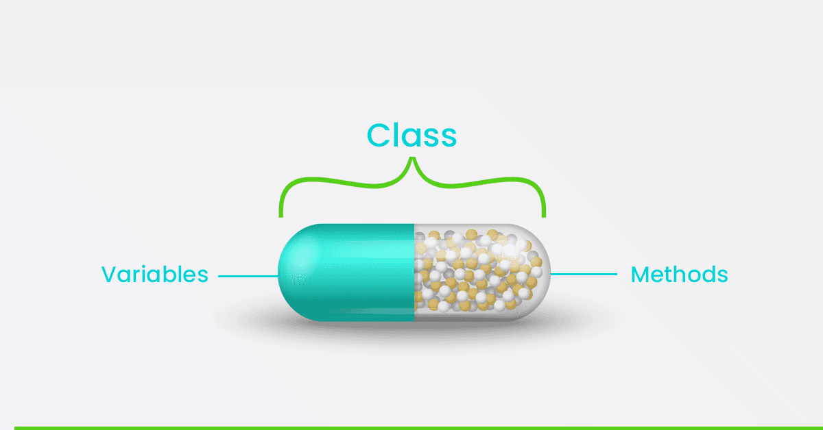

Slide 3
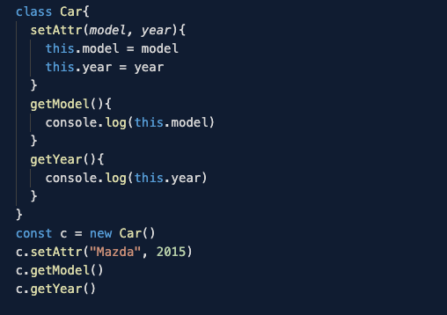

Slide 4
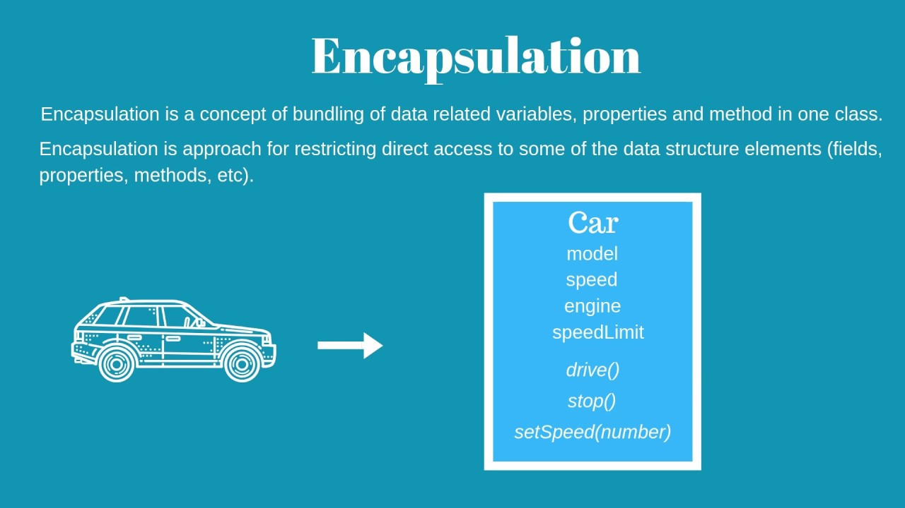

Slide 5
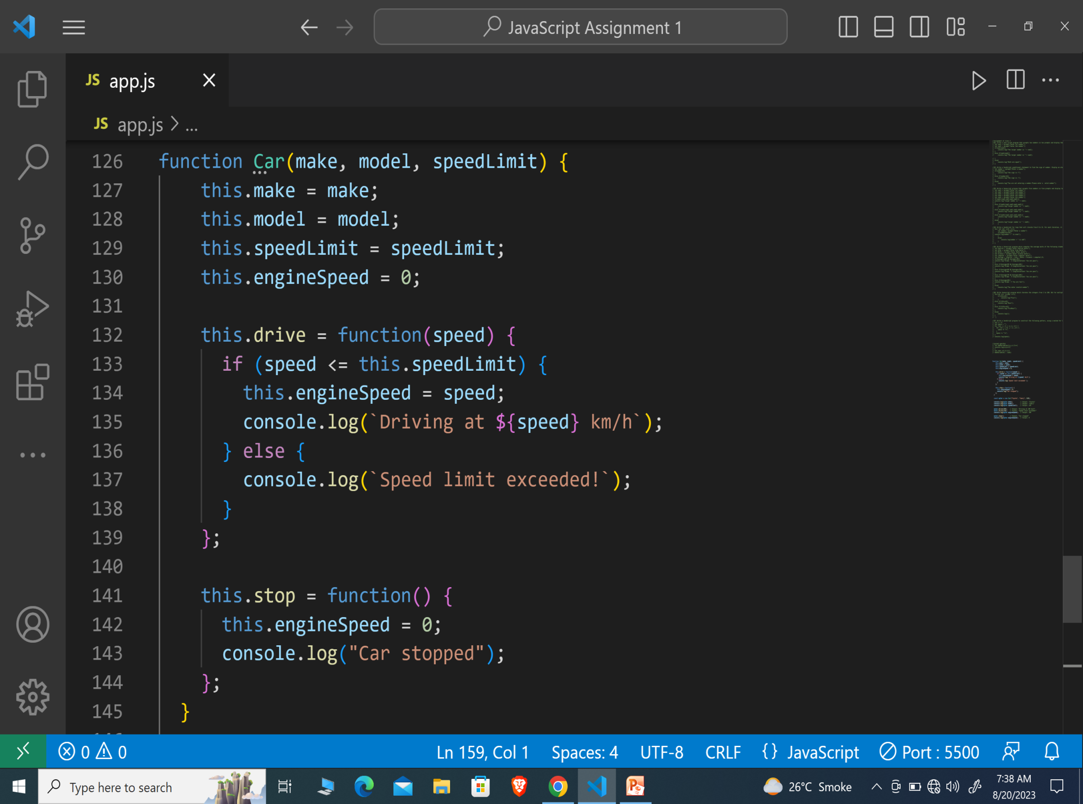

Slide 6
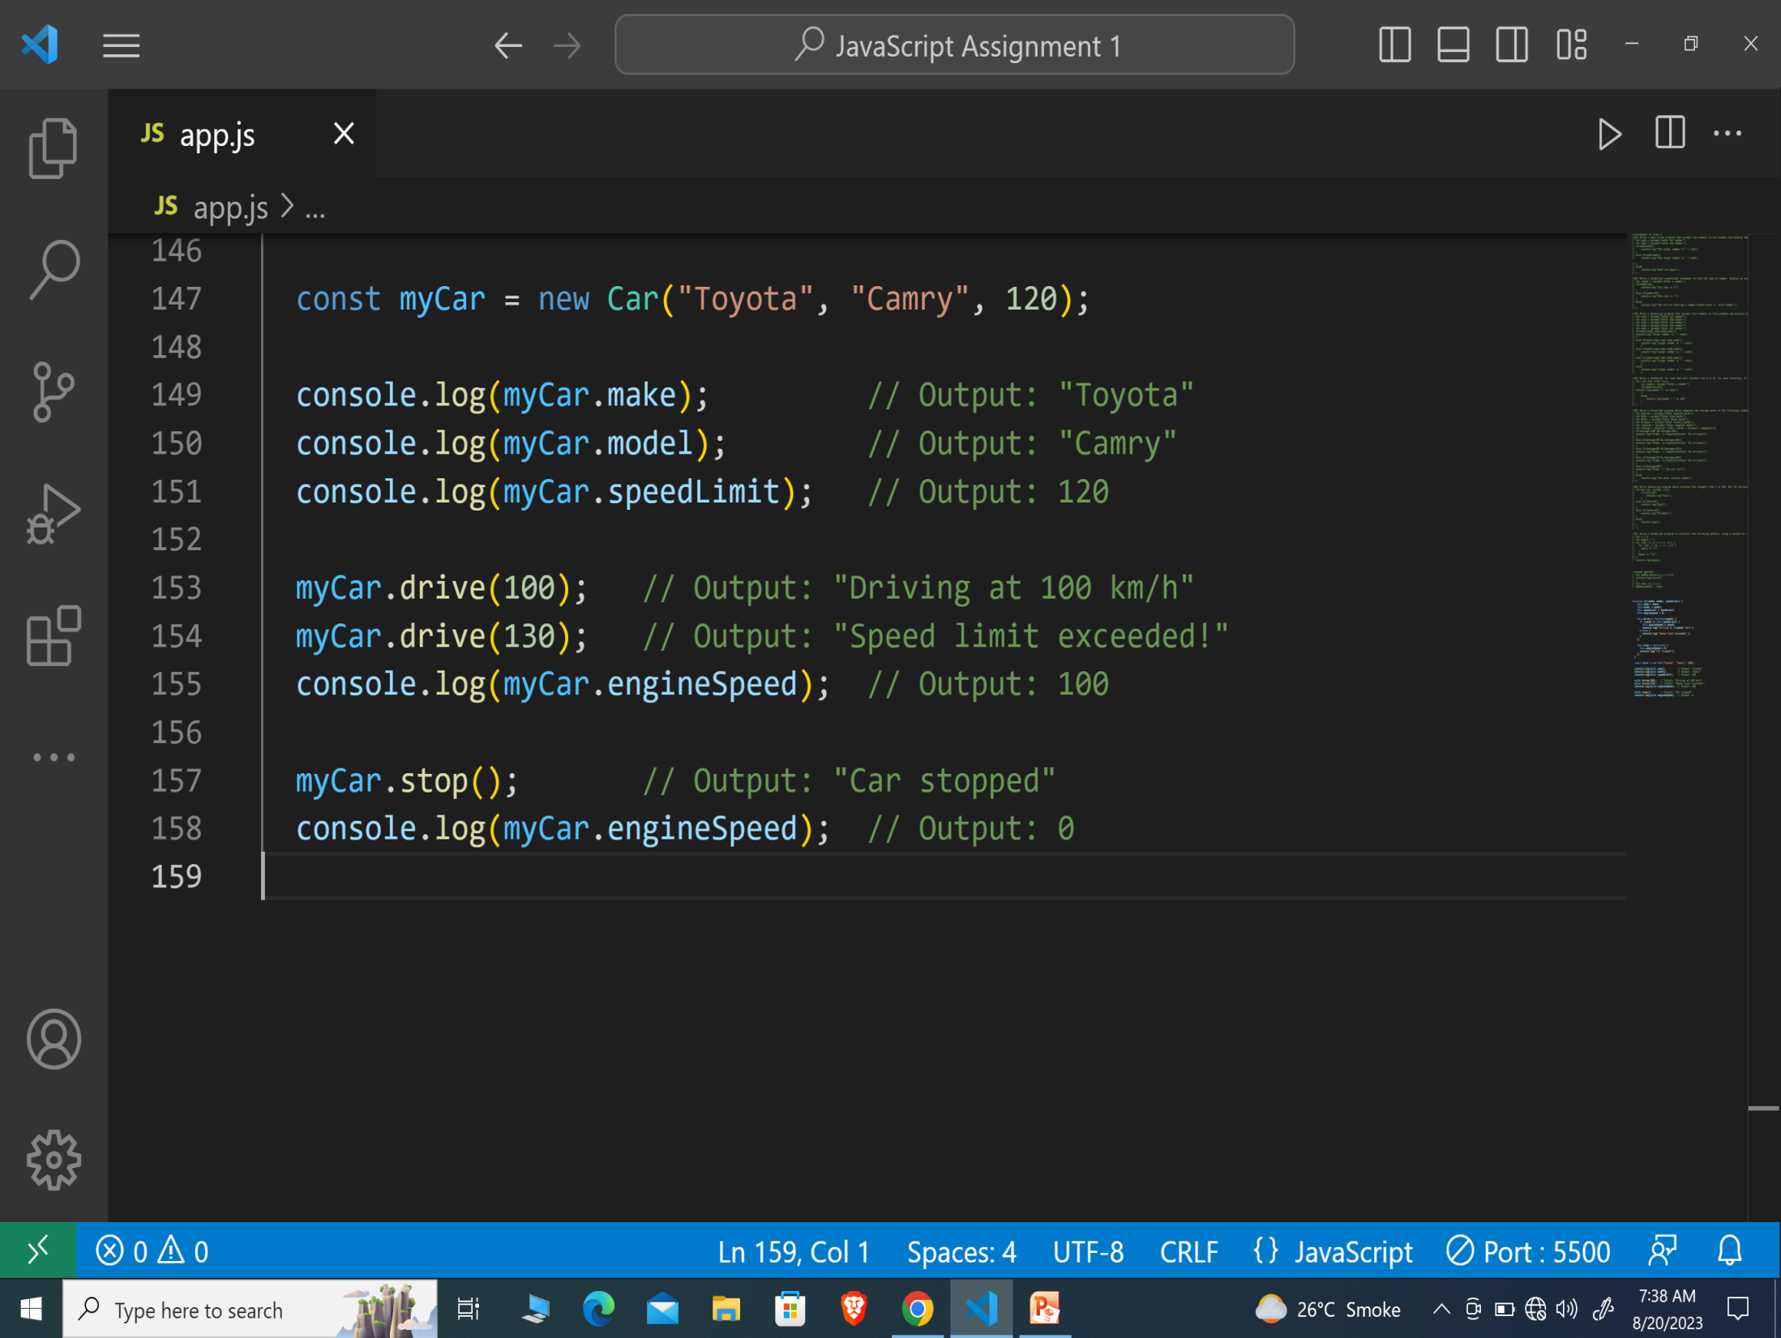

Slide 7
